Slide 1
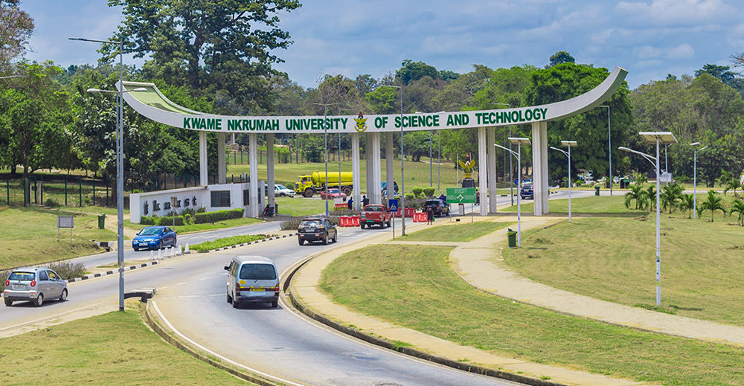
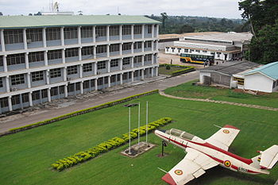
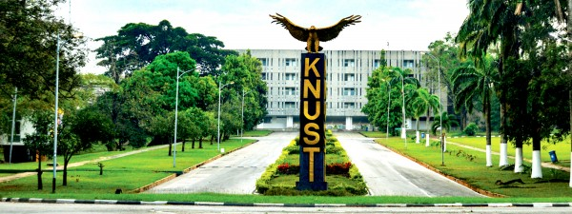
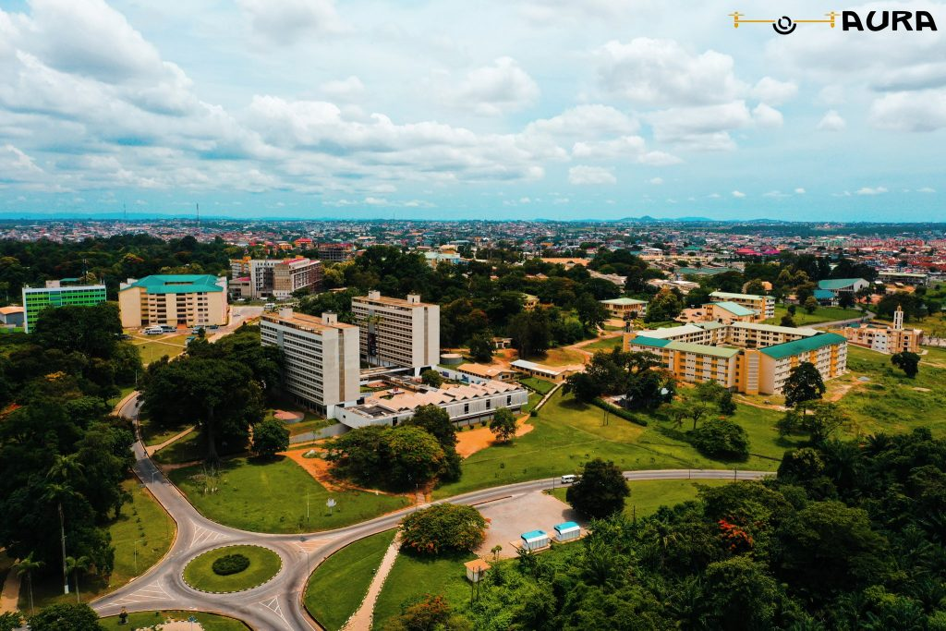
Kwame Nkrumah University of Science and Technology (KNUST)

Slide 2

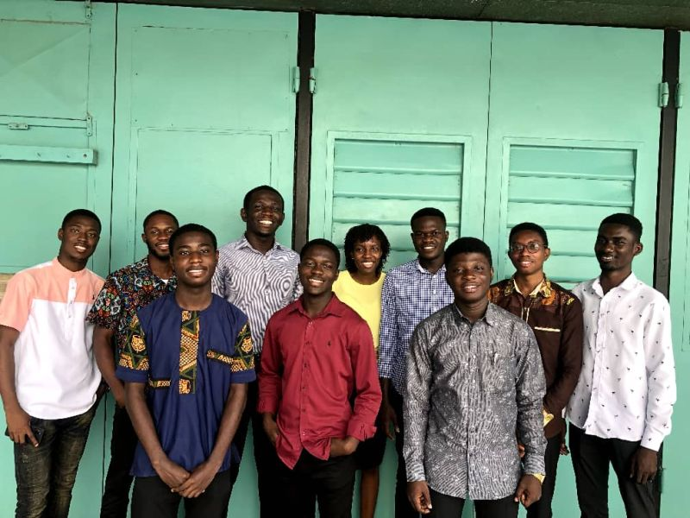
About Me
Yes. I had my bachelors degree in Electrical/Electronics Engineering.
The exceptional first class students were retained as Teaching Assistants (TAs).
Our annual graduation event was organized online due to COVID 19😈😈
We were 10 TAs in all. 8 of us are furthering our education outside the country

Slide 3
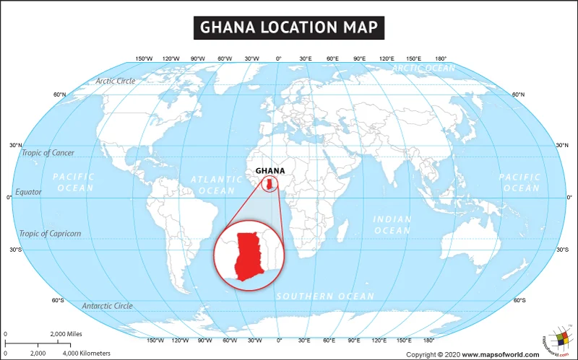
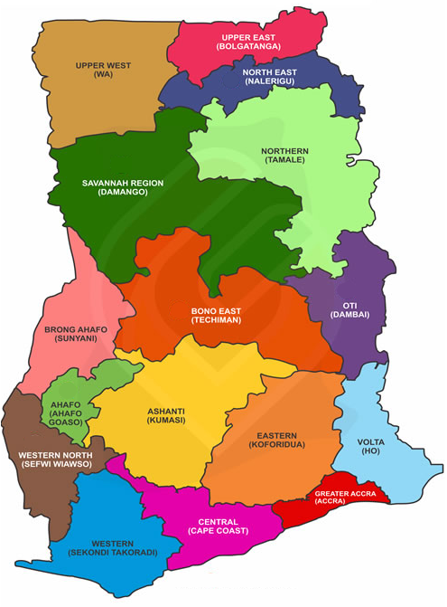
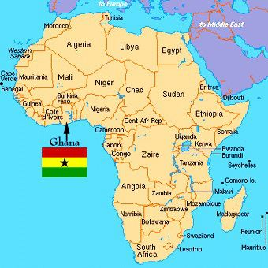
What do you know about the country, Ghana?
Ghana is in West Africa.
Ghana is the second most populous country in West Africa with about 33 million people.
Ghana has 16 regions.
Ghana was colonized by the British.
While Ghana was under colonial rule, it was known as the Gold Coast.
Ghana gained independence in 6th March, 1957
Although English is Ghana’s official language, there are about 50 local languages.

Slide 4
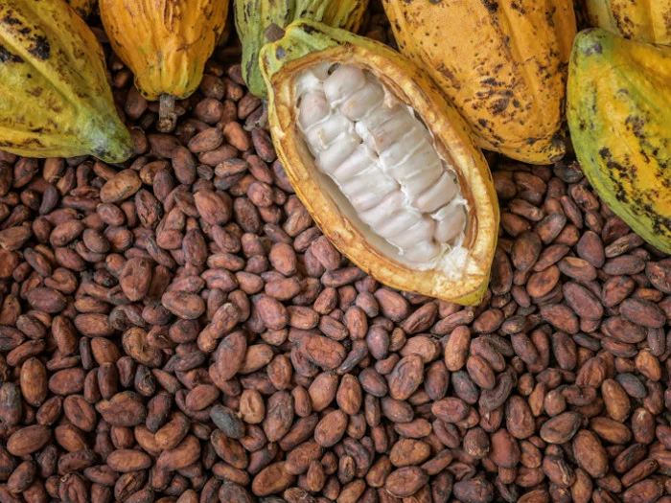
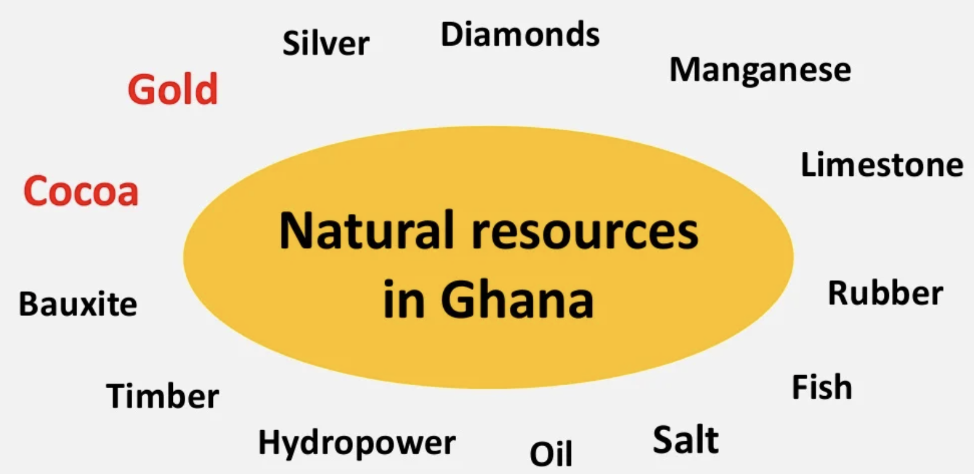
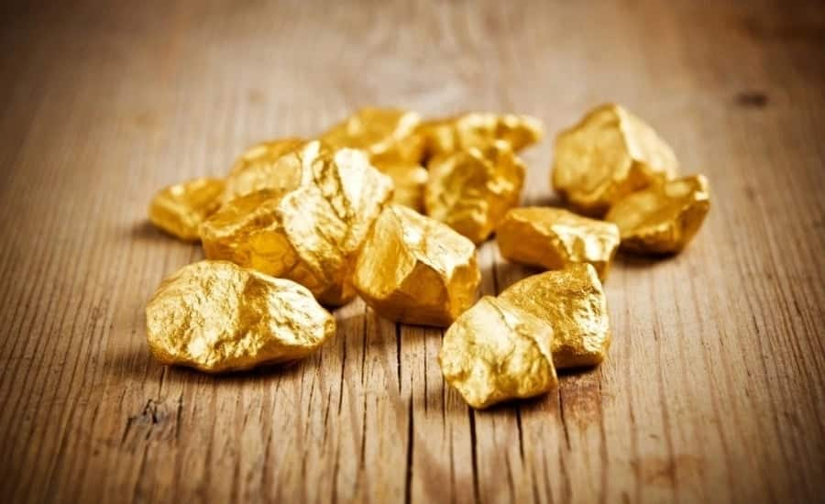
Our Natural Resources
Ghana produces high-quality cocoa. It is the 2nd largest producer of cocoa globally
As of 2019, Ghana was the 7th largest producer of gold in the world, producing ~140 tonnes that year.
COCOA
GOLD

Slide 5
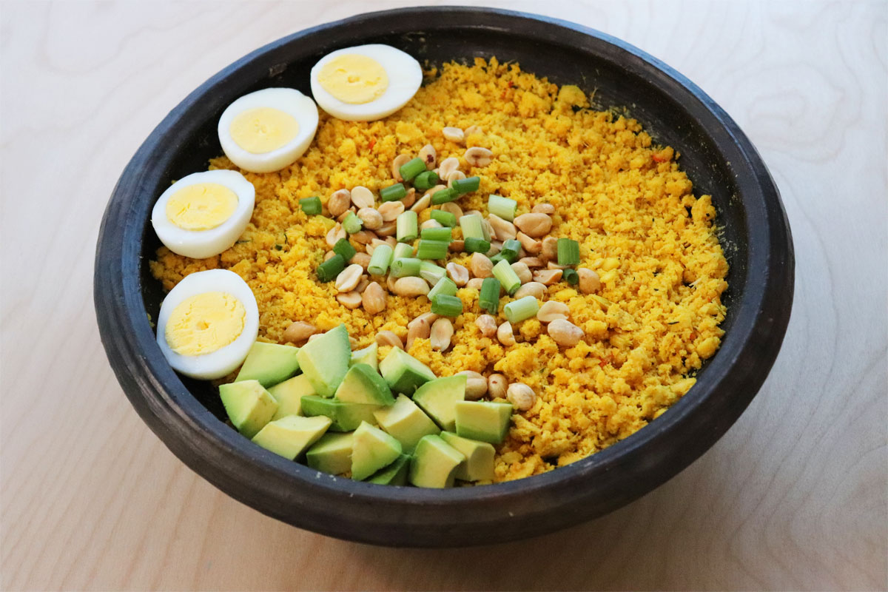
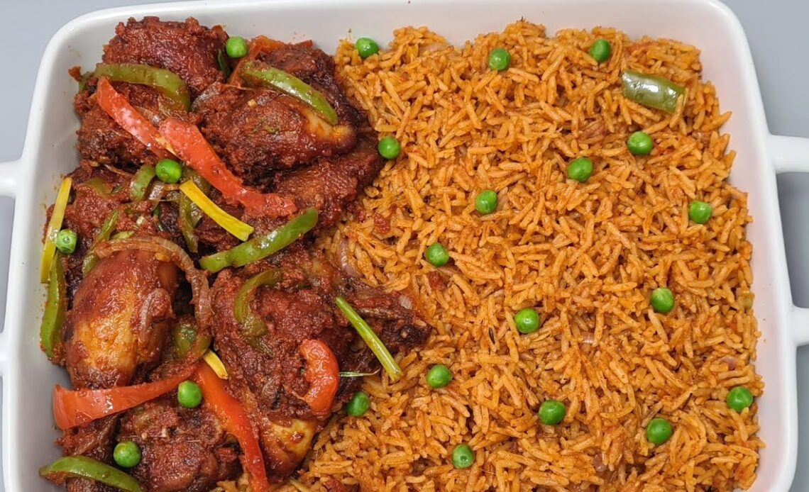
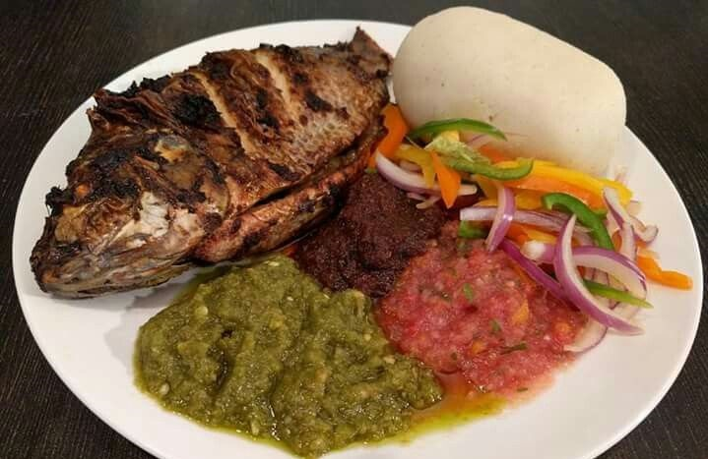
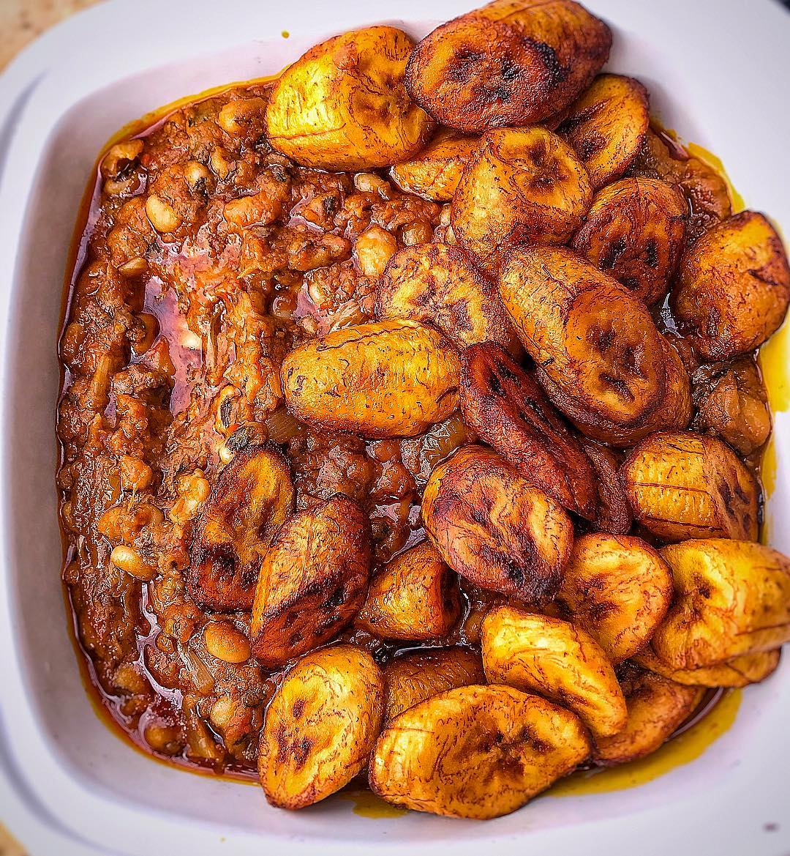
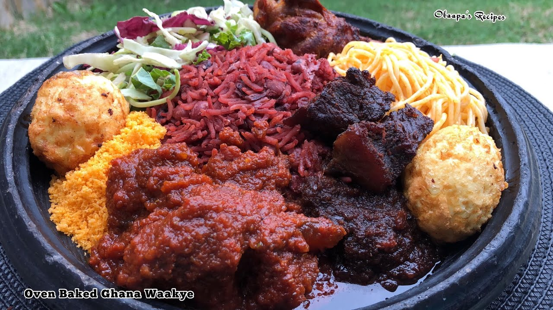
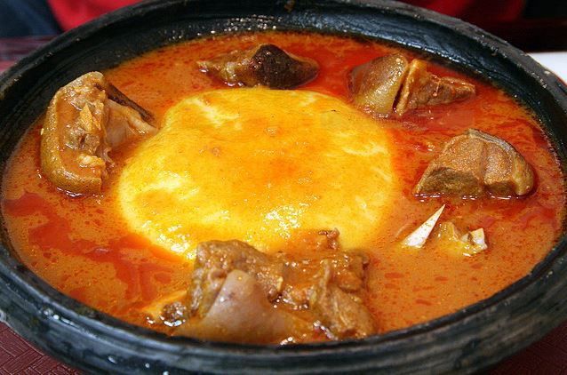
How is Ghana’s Food Like?
ƹTƆ
JOLLLOF
BANKU
GƆBƹ
WAAKYE
FUFU AND LIGHT SOUP

Slide 6
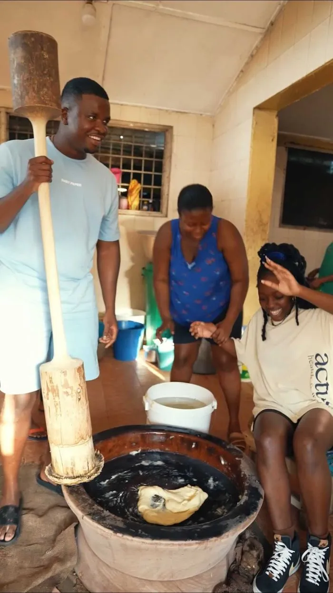
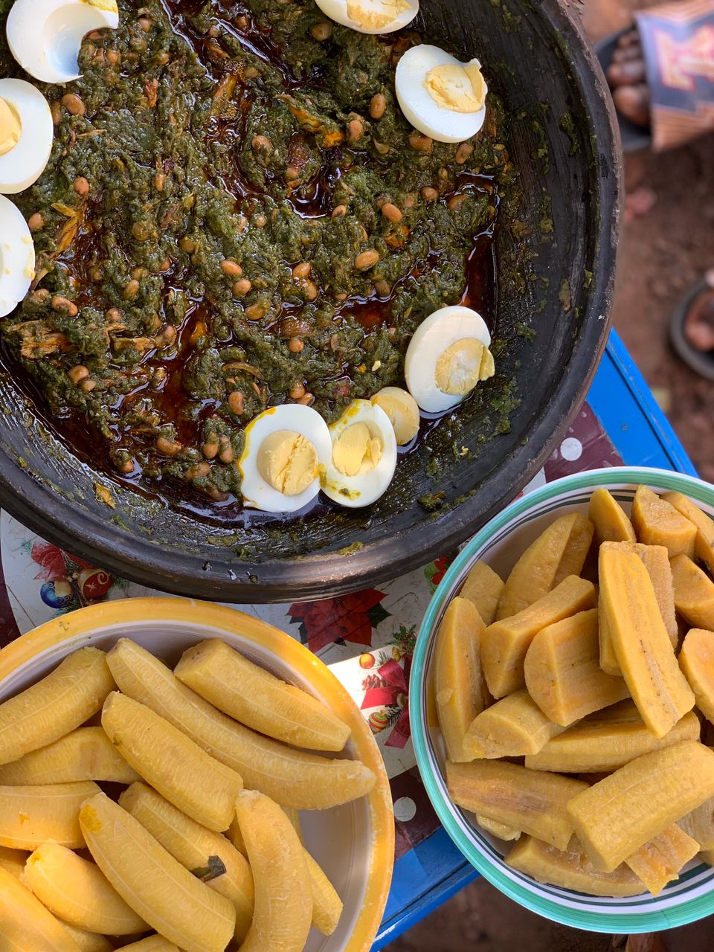
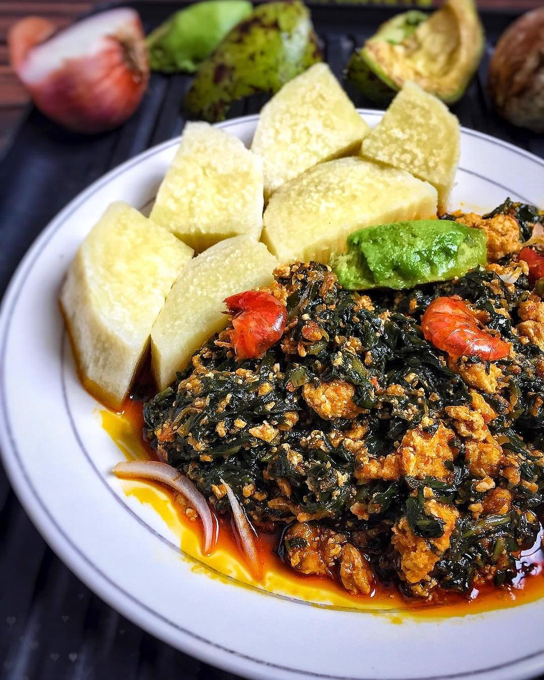
More Ghanaian food?
AMPESI (PLANTAIN OR YAM) WITH KONTOMIRE STEW
This is how Fufu is pounded. There is a fufu pounding machine but most people want it this way.

Slide 7
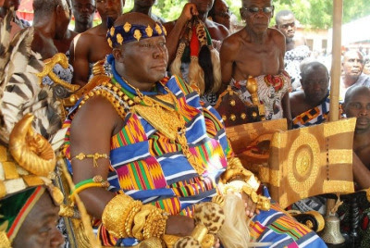
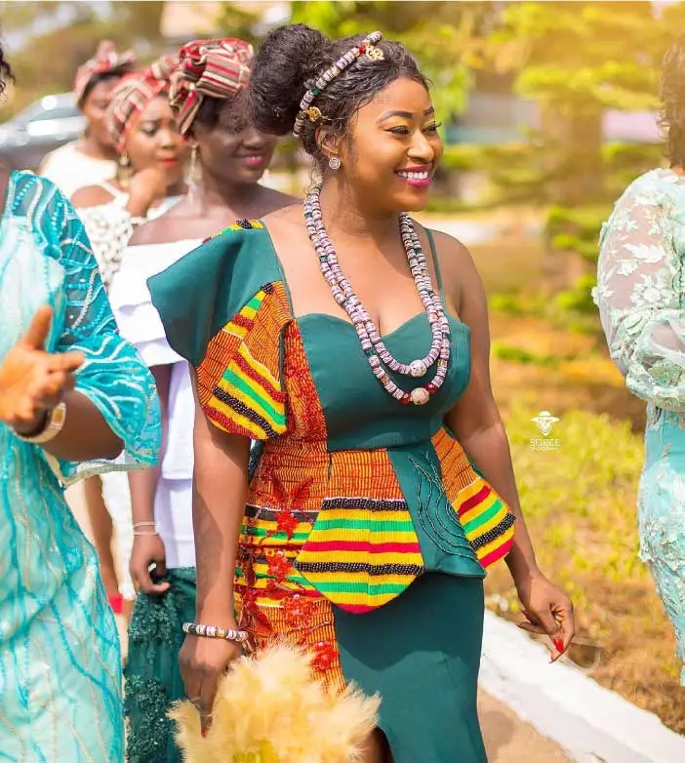
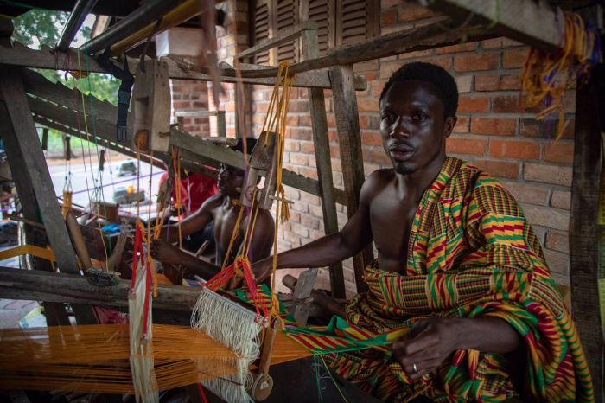
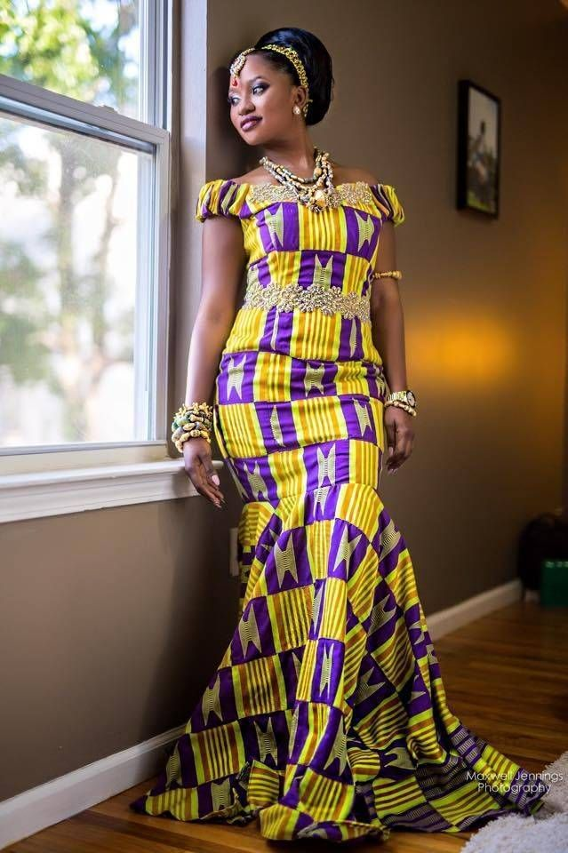

Kente Cloth

Slide 8
Any questions about Ghana you would like to know?

Slide 9
THANK YOU!!!!
References
https://www.mapsofworld.com/ghana/ghana-location-map.html
https://earthobservatory.nasa.gov/
https://www.slideshare.net/frankcalberg/ghana-13949811

